Slide 1

SEBUT HARGA PEROLEHAN MEMBEKAL DAN MENGHANTAR KASUT PEJABAT, KASUT TAKTIKAL DAN KASUT KESELAMATAN KEJURUTERAAN UNTUK KEGUNAAN JBPM NEGERI PERAK TAHUN 2024
QT240000000005360
18 MAC 2024
10.00 PAGI

Slide 2
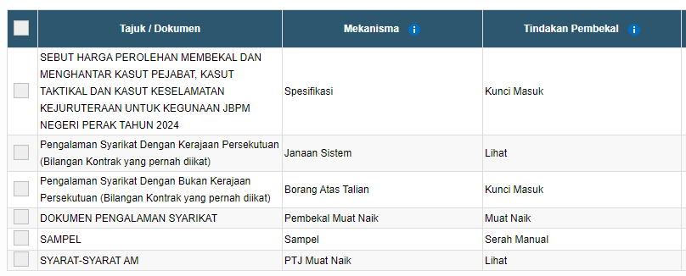
SENARAI SEMAK TEKNIKAL
TEXT / YA / TIDAK
MENGUNCI MASUK PENGALAMAN SYARIKAT BUKAN KERAJAAN
MUAT NAIK DOKUMEN PENGALAMAN SYARIKAT
SYARAT-SYARAT AM

Slide 3

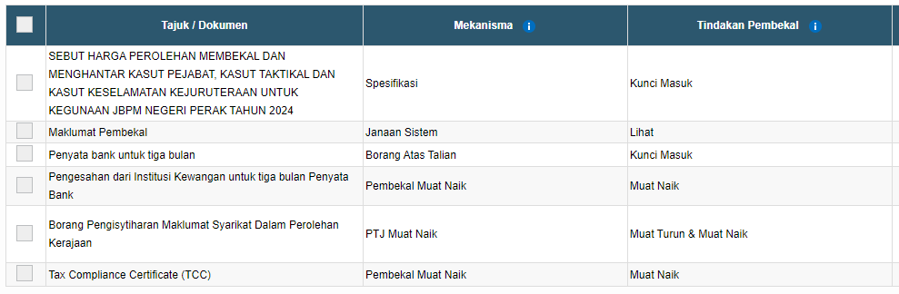
SENARAI SEMAK KEWANGAN
MENGUNCI MASUK HARGA SEUNIT
SILA PASTIKAN LENGKAP
MENGUNCI MASUK PENYATA BANK 3 BULAN (NOVEMBER 2023 – JANUARI 2024)
MEMUATNAIK PENYATA BANK YANG TELAH DISAHKAN OLEH BANK
* Pembekal akan gagal sekiranya amaun tidak sama di sistem
MENGISI BORANG PENGISYTIHARAN MAKLUMAT SYARIKAT
MEMUAT NAIK TAX COMPLIANCE CERTIFICATE

Slide 4
SYARAT-SYARAT AM
AM
1.1 Spesifikasi ini adalah keperluan teknikal untuk pembekalan kasut untuk Jabatan Bomba Dan Penyelamat Malaysia ( JBPM) Negeri Perak
SKOP
2.1 Spesifikasi teknikal ini adalah garis panduan kepada keperluan untuk pembekalan kasut yang akan digunakan oleh pihak Jabatan Bomba dan Penyelamat Malaysia Negeri Perak Sebagai kelengkapan pakaian seragam dan operasi bagi operasi kebakaran dan menyelamat.
PERKARA AM
3.1 Kasut yang hendak dibekalkan harus mengikut kehendak spesifikasi pihak jabatan.
3.2 Syarikat pembekal harus berdaftar dengan Kementerian Kewangan Malaysia

Slide 5
SYARAT-SYARAT AM
PACKAGING / LABELLING (MANDATORY)
4.1 The shoes shall be wrapped in tissue paper and packed in individual card box shoe box in matched pairs.
4.2 The individual card box shoe box to be marked showing: -
4.2.1 Supplier name, address, phone and fax number on the top of the box.
4.2.2 Art number, shoe size and color on the side of the box.
4.3 10 pairs same sizes will be packed in carton box.
4.4 The carton box shall be marked with the following detail and other marking as specified in the contract:
4.4.1 Supplier name, address and contact number;
4.4.2 Contract number;
4.4.3 the sizes and quantity,

Slide 6
SYARAT-SYARAT AM
PHYSICAL EVALUATION.
5.1 Physical Evaluation. Tenderer shall provide Four (4) pairs samples (size 8) of the product for physical evaluation.
QUALITY ASSURANCE PROVISION
6.1 The tenderer shall perform all examination and tests specified in this specification and forward the certificate of compliance to FRDM.
6.2 FRDM reserves the rights to perform any examination which is deemed necessary to ensure the supplies conform to the specification requirements.
6.3 All supply shall be subjected to the approval of the Delivery Committee. Any supplies which in the opinion of this Committee are inferior quality of material or workmanship or differs in any respect from this specification may be rejected by them.

Slide 7
SYARAT-SYARAT AM
QUALITY ASSURANCE PROVISION (Continued)
6.4 In the case of inspection at the factory site, the Committee shall have free access to the factory premises before, during and after production of the item. The factory management shall accord this officer with the necessary facilities within the factory premises to enable him to freely carry out the inspection.
WARRANTY
7.1 The tenderer shall guarantee every shoe against defects in the manufacture, or any defects arising out of design, or faulty materials, or workmanship, or any malfunction due to quality of materials, workmanship and design for a period of 6 months from the date of acceptance. Any defect item will be replaced by the tenderer. All cost involved including replacing item and transportation will be borne by the tenderer.

Slide 8
SYARAT-SYARAT AM
DELIVERY
8.1 The tenderer shall deliver all the goods within 90 days after the date of the letter of acceptance.
8.2 All the goods shall be delivered to Fire and Rescue Department, Malaysia, Perak, Persiaran Meru Utama, Meru Raya, 30020 Ipoh, Perak or other places that will be designated by the department.
ATTENDBRIEFINGS
9.1 All tenderers /Interested suppliers interested in participating in the quotation above must attend a special briefing on the matter to be determined later.

Slide 9

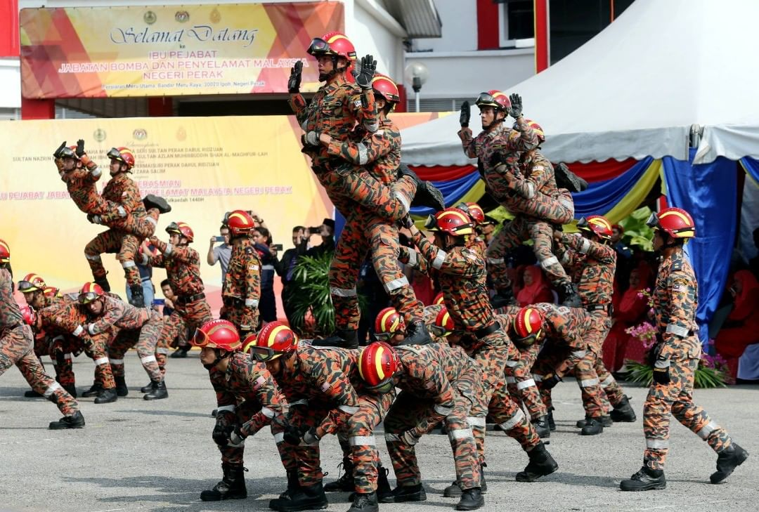
TERIMA KASIH

